Slide 1
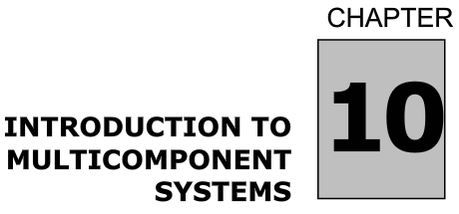
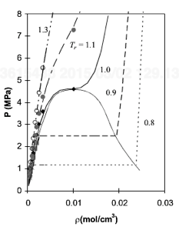
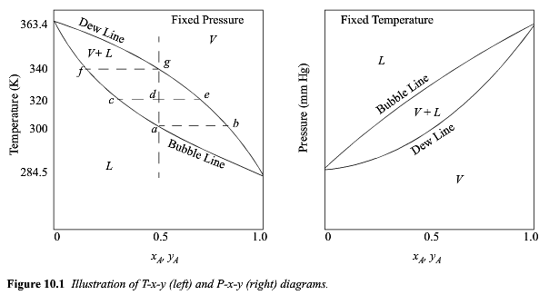
Components
Phases
Degrees of Freedom
Single Component
Two Components
Composition is the other DOF

Slide 2
Components
Phases
Degrees of Freedom

Slide 3



Slide 4


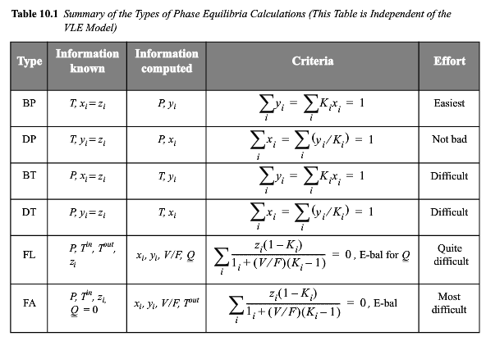
Raoult’s Law
P₁ = P₁^{sat} x₁
(y₁ =P₁/P)

Slide 5
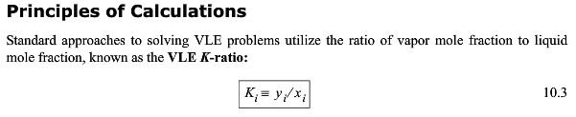
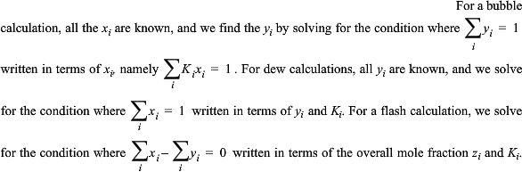
(Like a Solution Ideal Gas law)
More Complex EOSs are presented in later chapters

Slide 6
DePriester Chart for the K-ratio (T, P)
K_{i} = y_{i}/x_{i}

Slide 7
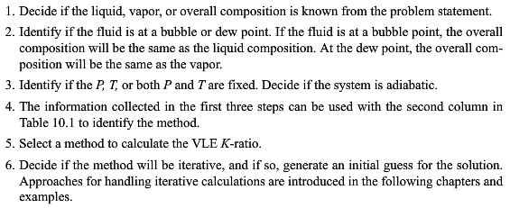

Slide 8
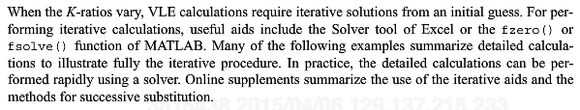

Slide 9
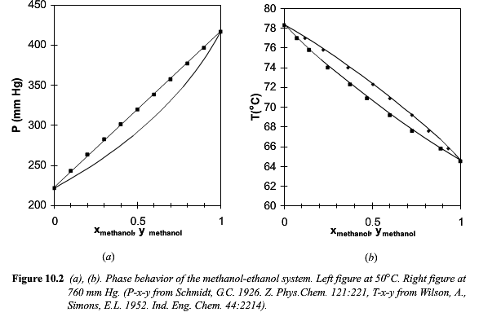
P₁ = P₁^{sat} x₁
(y₁ =P₁/P)

Slide 10
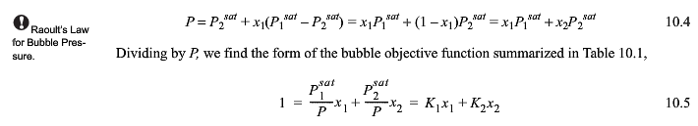

Slide 11
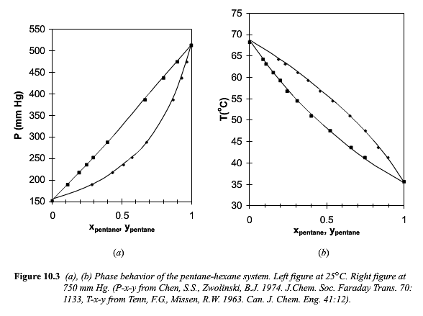

Slide 12
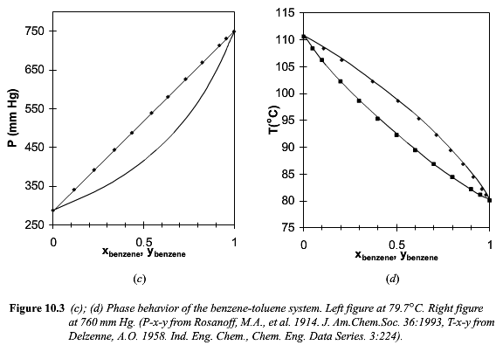

Slide 13

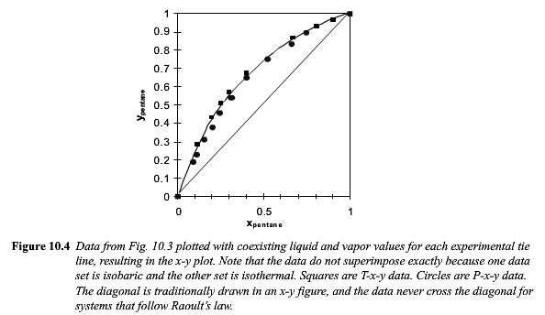

Slide 14

T_{r} > 0.5

Slide 15


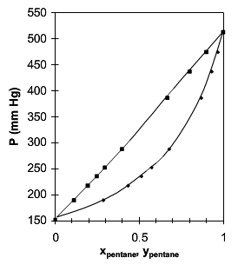

Slide 16
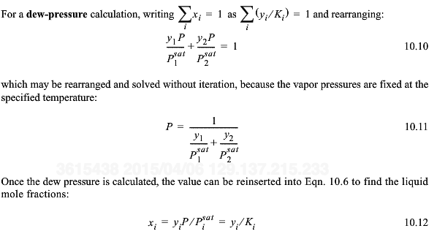

Slide 17
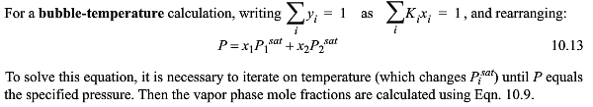
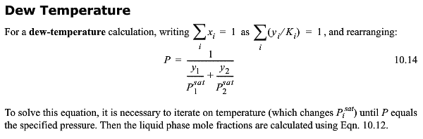

Slide 18
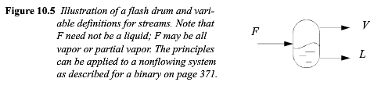



Slide 19
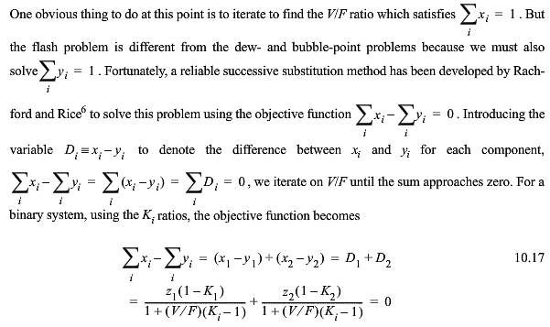

Slide 20
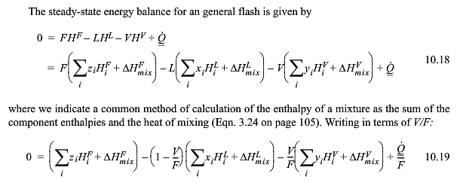

Slide 21
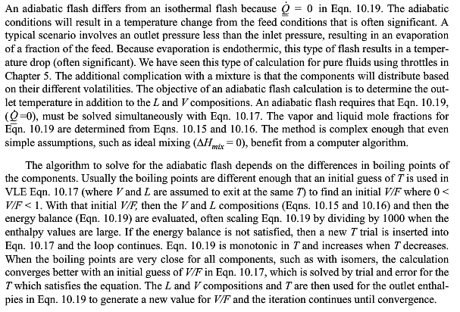

Slide 22

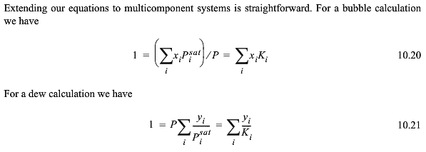
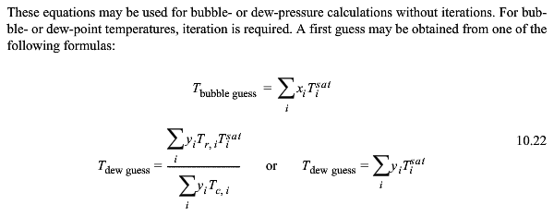

Slide 23
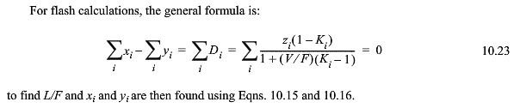

Slide 24
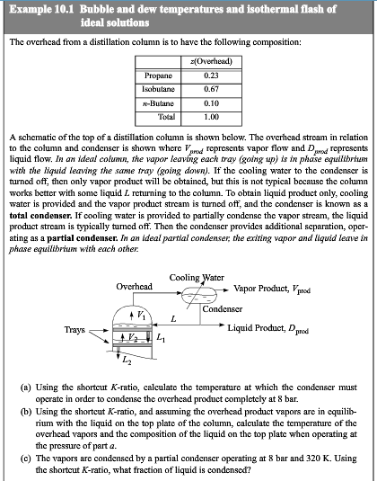

Slide 25
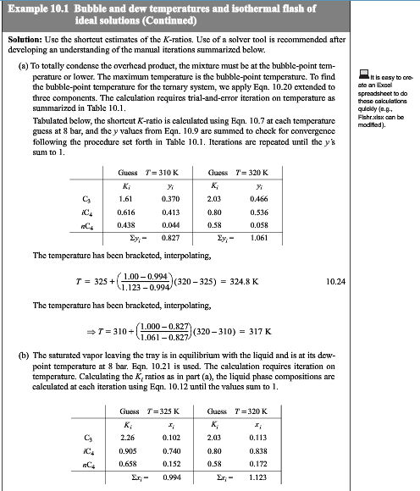
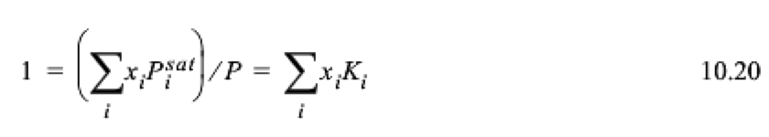


Slide 26
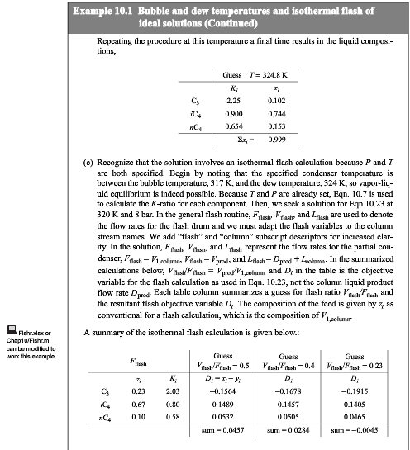


Slide 27
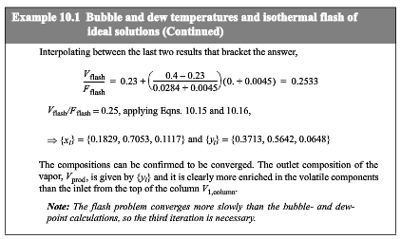

Slide 28
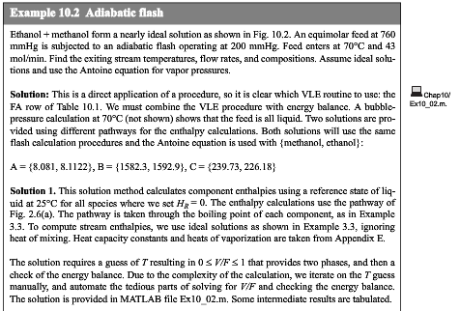
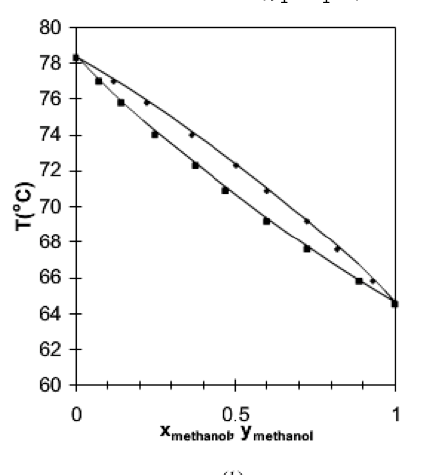
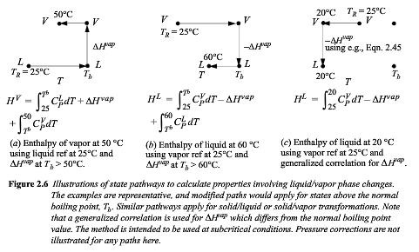

Slide 29
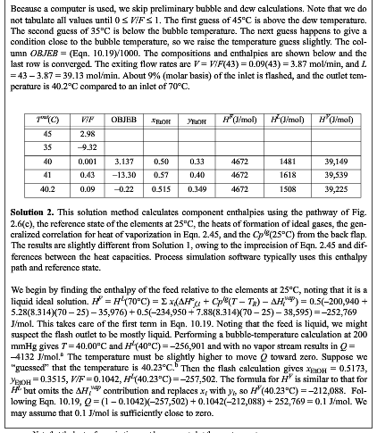




Slide 30

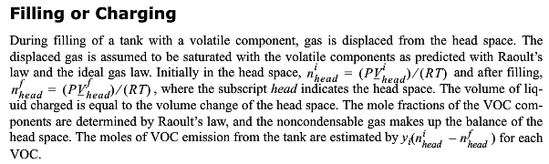

Slide 31
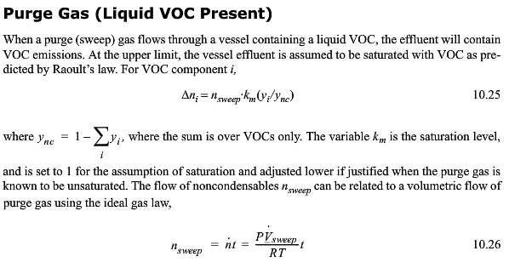

Slide 32

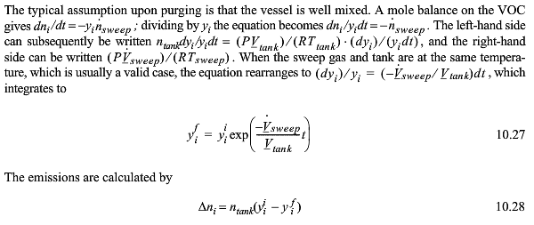
The rate of change in y_{i} depends on y_{i}, the rate of sweep and is inverse to the tank volume dy_{i}/dt = -y_{i} (dV/dt)/V

Slide 33
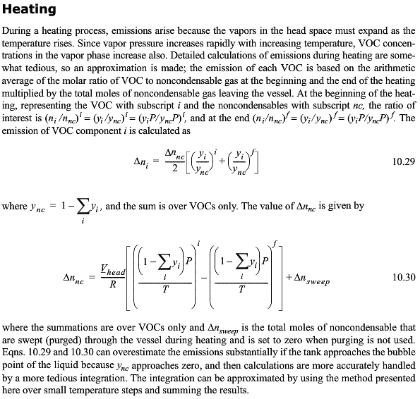

Slide 34

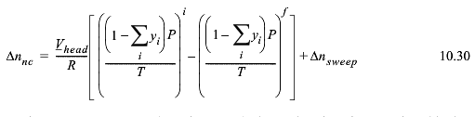

Slide 35
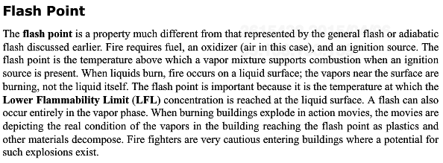



Slide 36
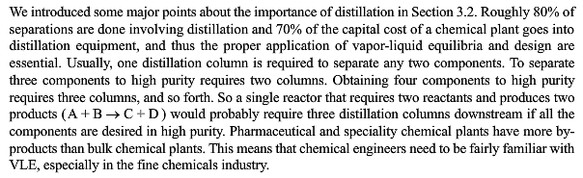

Slide 37
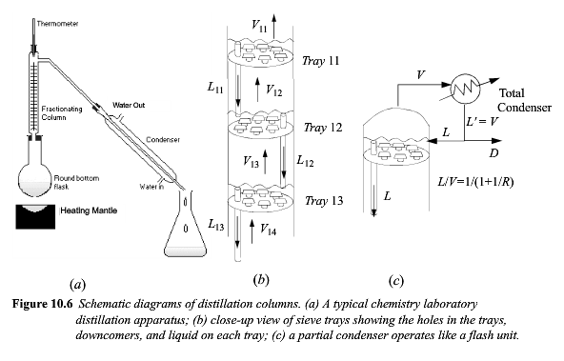
R=L/D

Slide 38
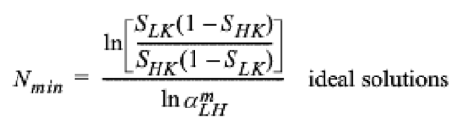
Light key, lightest (most volatile) component with a split (fraction in the distillate) > 0.5
Heavy key, heaviest (least volatile) component with a split (fraction in the distillate) < 0.5
Relative volatility α_{LH} = K_{LK}/K_{HK} = P^{sat}_{LK}/P^{sat}_{HK} (by Raoult’s Law)
Fenske equation

Slide 39

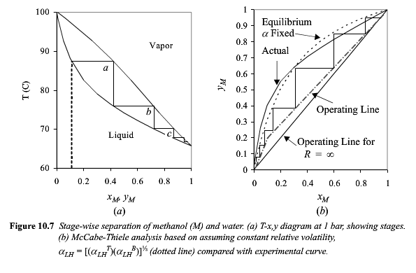
Relative Volatility
R=L/D

Slide 40
Relative Volatility

Slide 41
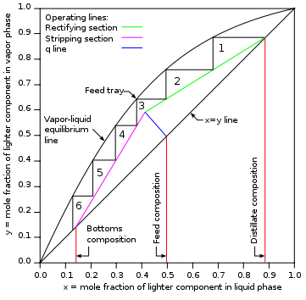
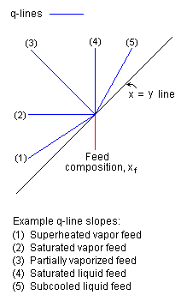
McCabe-Thiele
Method
(1-q)/q
Draw for LK
Or Lower Boiling
Component
From wikipedia

Slide 42
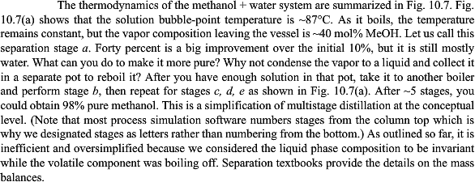
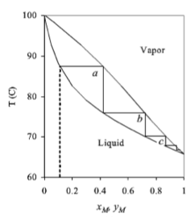

Slide 43
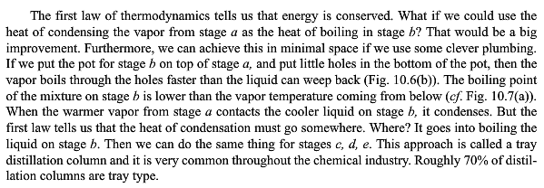

Slide 44


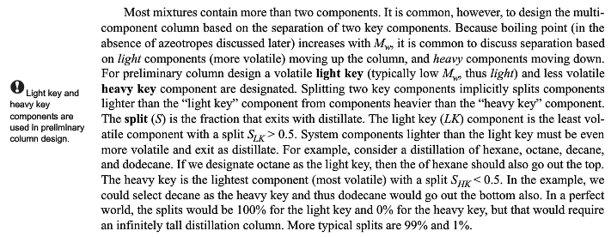

Slide 45
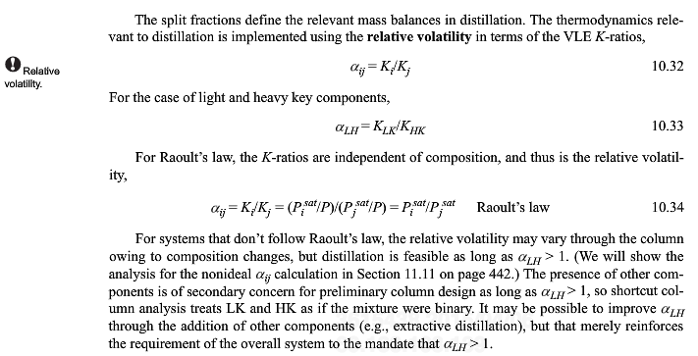

Slide 46





Slide 47



Slide 48


Slide 49


Ideal system versus non-ideal systems
Positive Deviation
From Raoult’s Law
Minimum Boiling Azeotrope
(Maximum Pressure)
Negative Deviation
Maximum Boiling Azeotrope
(Minimum Pressure)
Acetone/Chloroform
Negative
deviation
Maximum Boiling
Azeotrope
Minimum Boiling
Azeotrope
Attraction to
opposite type
Propanol/Water
Positive deviation
Attraction to own type

Slide 50


Slide 51

Minimum Boiling
Azeotrope
Propanol/Water
Positive deviation
Attraction to own type

Slide 52




Slide 53


Slide 54

Acetone/Chloroform
Negative
deviation
Attraction to
opposite type
Maximum Boiling
Azeotrope

Slide 55





Slide 56





Consider if the amount of material changes
Such as when two phases are in contact
Use extrinsic values to allow for change in amount

Slide 57





Slide 58


Slide 59



Slide 60





Slide 61




Slide 62



Slide 63




T

Slide 64



Slide 65







Slide 66


Slide 67



